Slide 1

The EU27 chemical industry remains under pressure despite improving confidence
To replace the background image:
1/Go to Slide Master (Menu “View”)
2/Right-click on the image
3/Select “Replace image…”
4/Close the Slide Master
Dr Moncef Hadhri
Chief Economist
mha@cefic.be

Slide 2
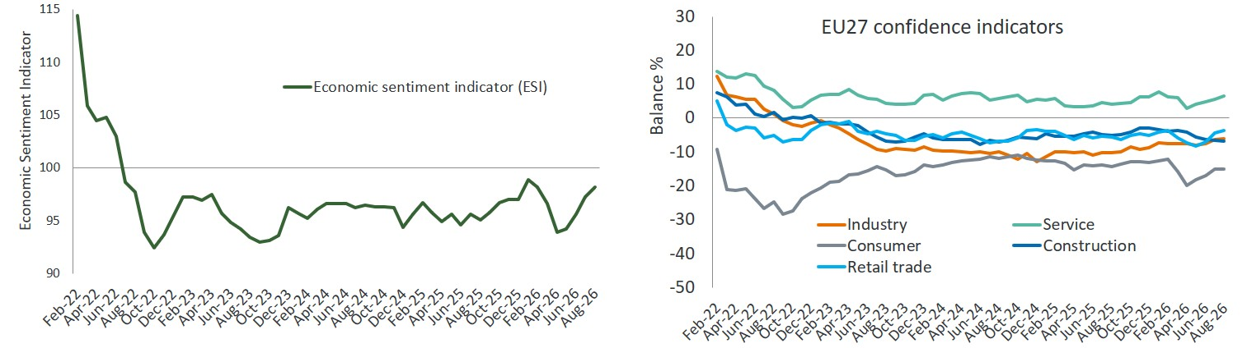
Economic Sentiment Indicator (ESI): sentiment increases, but remains below its long-term average
Source: EU Commission business and consumer survey results: Answers obtained from the surveys are aggregated in the form of balances, constructed as the difference between the percentages of respondents giving positive and negative replies.
Notes:
1. Economic Sentiment Indicator (ESI): sentiment improves, but remains below its long-term average
The EU27 Economic Sentiment Indicator (ESI) improved in the first eight months of 2026, rising from 95.5 to 96.6 compared with the same period of 2025. Despite this improvement, sentiment remained below its long-term benchmark of 100, indicating that the European economy continued to operate in a relatively weak environment. The improvement was mainly driven by stronger confidence in industry and services, while consumer confidence deteriorated, reflecting ongoing concerns about household finances and the broader economic outlook. Construction and retail trade sentiment remained broadly stable.
Source: EU Commission business and consumer survey results.
Latest-month assessment (August vs July 2026)
The latest survey points to a modest improvement in sentiment. The ESI increased from 97.2 in July to 98.2 in August, supported by stronger confidence in industry and services. However, consumer confidence remained weak, suggesting that household sentiment continues to lag behind the gradual improvement seen in business sectors
In summary
Economic sentiment in the EU27 improved in 2026, supported by stronger industry and services activity. However, the ESI remained below its long-term average, while weaker consumer confidence continued to weigh on the strength of the improvement.

Slide 3
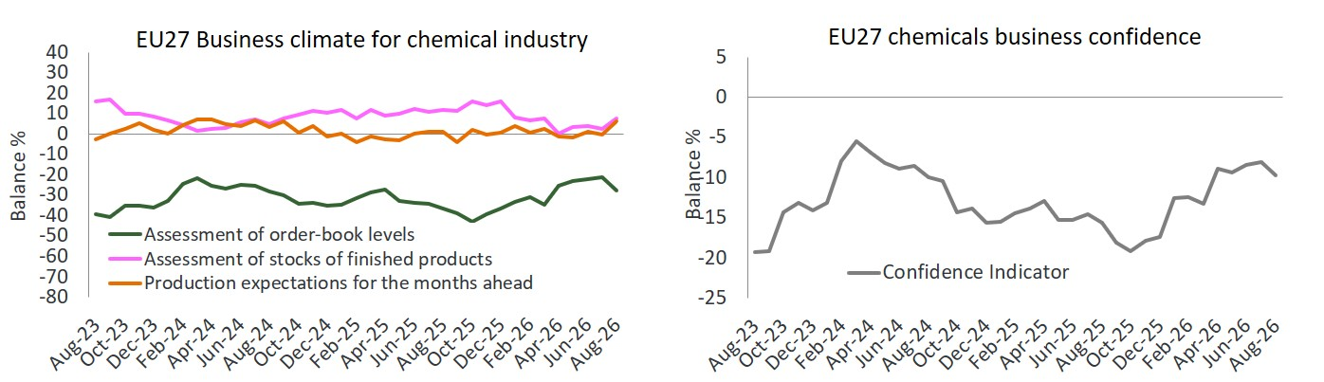
EU27 chemical business confidence improves, but remains weak
Source: EU Commission business and consumer survey results: Answers obtained from the surveys are aggregated in the form of balances, constructed as the difference between the percentages of respondents giving positive and negative replies.
Notes:
2. Business confidence improves, but demand remains weak
EU27 chemical business confidence improved from -14.7 to -10.3 in the first eight months of 2026. The recovery was supported by a stronger assessment of recent production, which improved from-11.7 to-4.0, and by production expectations turning positive at +1.5. Demand conditions remained weak, although order-book assessments improved and inventories declined, indicating that excess stocks are gradually being absorbed. Nevertheless, employment expectations deteriorated from-6.7 to-12.9, suggesting that producers remain cautious and that the recovery has yet to become broad-based
Source: European Commission Business and Consumer Surveys, NACE 20; Cefic analysis.
Latest-month assessment (August vs July 2026)
Business confidence eased slightly in August, with the confidence indicator falling from -8.1 in July to-9.7. Weaker assessments of recent production and order books point to continued softness in demand. However, production expectations improved from -0.2 to +6.4, suggesting that chemical producers remain cautiously optimistic about the months ahead
In summary,
The EU27 chemical business climate improved in 2026, supported by stronger production, improving order books and lower inventories. However, demand remained well below normal levels, while weaker employment expectations suggest that the recovery is still fragile and has yet to translate into stronger hiring intentions.

Slide 4
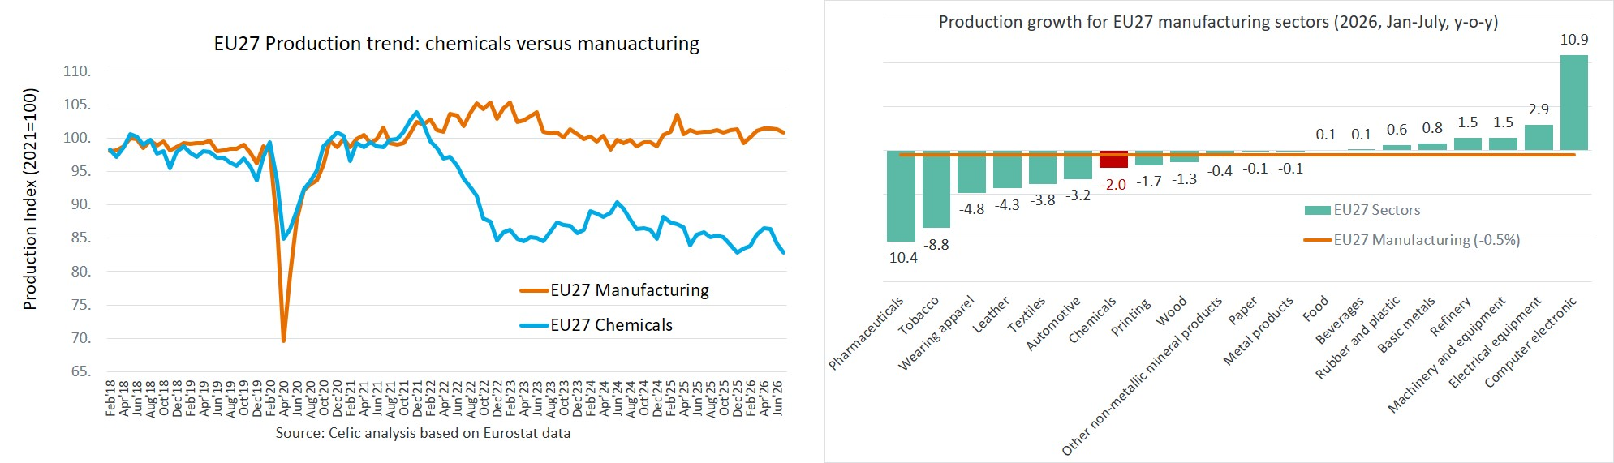
EU27 chemical production remains among the weakest-performing manufacturing sectors
Source: Cefic analysis based on Eurostat data, Nace 20 only
Notes:
4. EU27 chemical production remains among the weakest-performing manufacturing sectors
EU27 chemical production declined by 2.0% in the first seven months of 2026 compared with the same period of 2025, while total manufacturing output fell by only 0.5%. As a result, chemicals remained one of the weakest-performing major manufacturing sectors in Europe. While several technology- and investment-driven industries returned to moderate improvement, chemical producers continued to face weak demand and challenging market conditions.
Source: Cefic analysis based on Eurostat data.
The longer-term picture remains challenging. Despite several years of adjustment, EU27 chemical production remained 11.7% below its pre-crisis average (2014-2019) in 2026. In contrast, overall manufacturing output stood 5.8% above its pre-crisis level. This persistent gap points to ongoing competitiveness challenges and continued weakness across several chemical value chains.
Latest-month assessment (July vs June 2026)
The latest data suggest that the sector remained under pressure in July 2026. EU27 chemical production fell from 84.2 in June 2026 to 82.8 in July 2026 (-1.6%), while total manufacturing output also edged lower from 101.3 to 100.8. At the same time, production in the automotive industry dropped sharply from 105.9 to 99.8, indicating a broader loss of momentum across parts of European manufacturing.
In summary
EU27 chemical production weakened again in 2026, declining by 2.0% year-on-year and continuing to underperform total manufacturing. While several technology-intensive sectors are growing, chemical output remains 11.7% below pre-crisis levels, indicating that the sector continues to lag the broader industrial recovery.

Slide 5
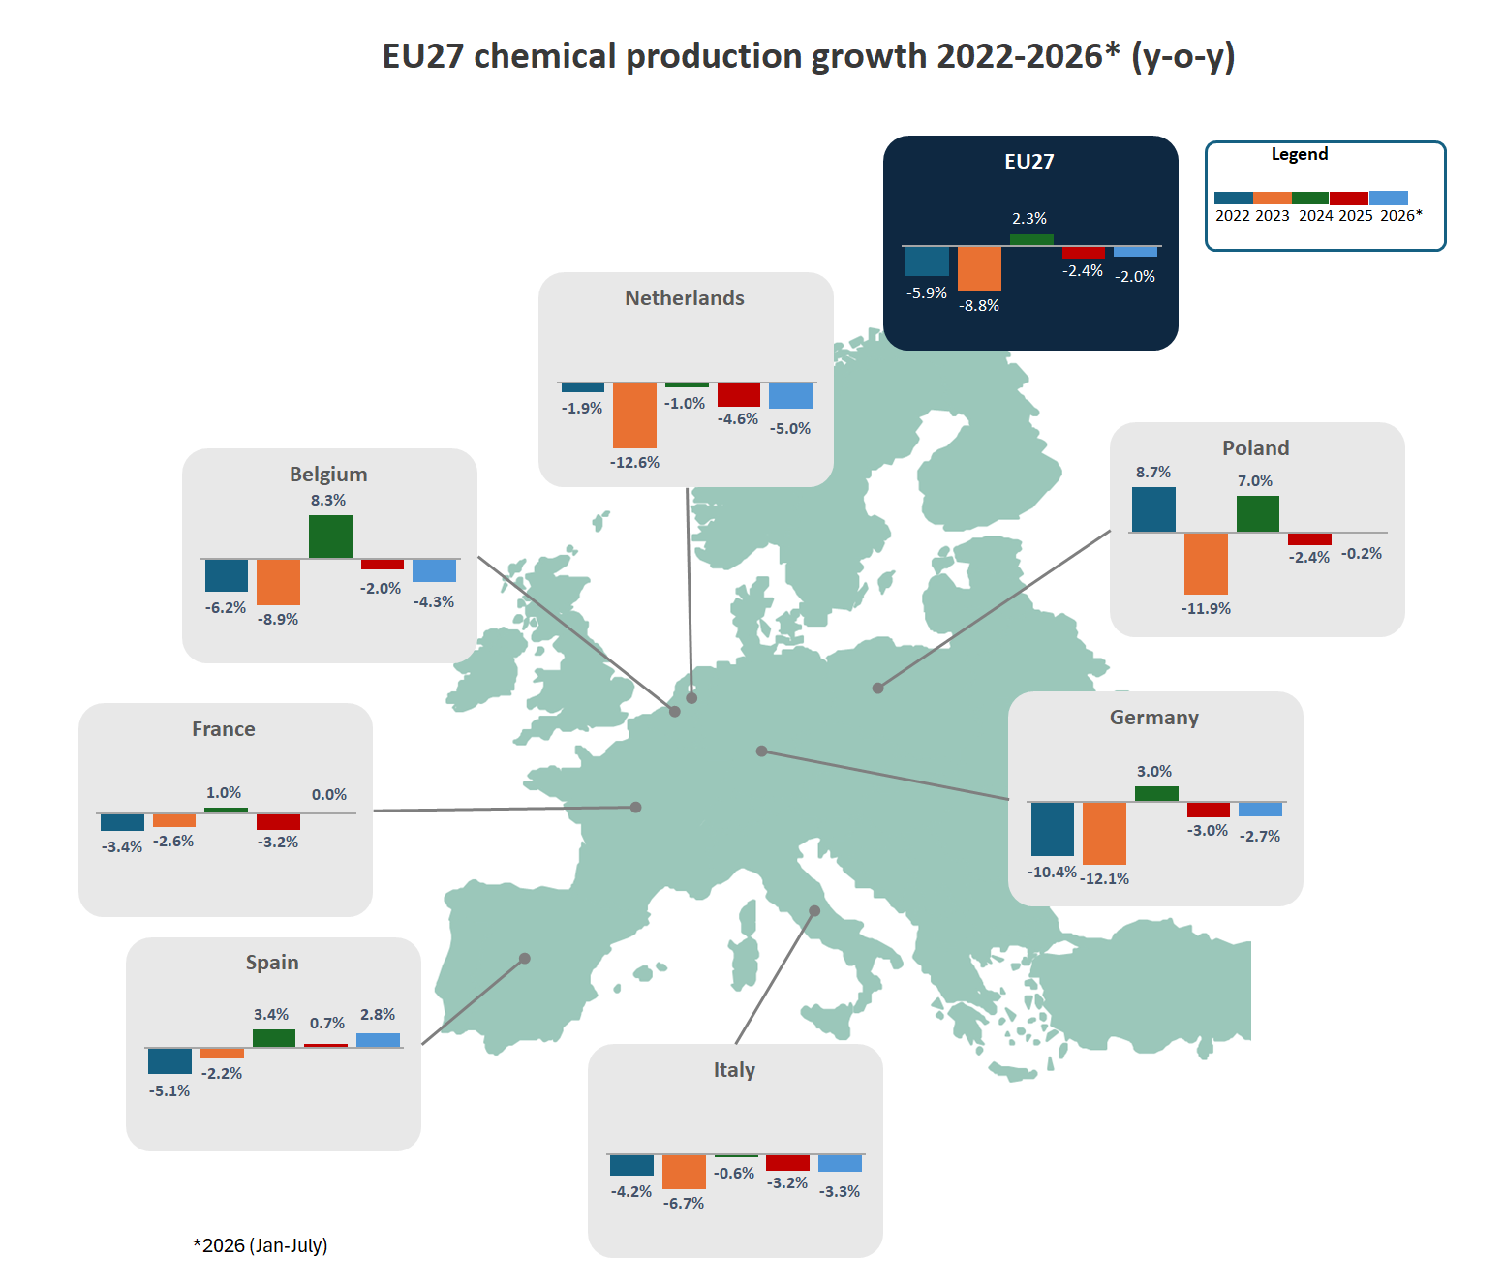
Strong production disparities across Member States
Source: Cefic analysis based on Eurostat data, Nace 20 only.
Notes:
5. Strong production disparities across Member States
EU27 chemical production declined by 2.0% year-on-year in January-July 2026, but national performances continued to differ significantly across Member States. Spain remained the strongest-performing major chemical producer, with output increasing by 2.8%, extending the recovery already observed in 2024 and 2025. France broadly stabilised, with production remaining unchanged compared with the same period of 2025, making it one of the few major producing countries to avoid a further decline. Poland also proved relatively resilient, with production declining by only 0.2%, considerably less than the EU27 average. In contrast, several of Europe's largest chemical-producing countries continued to experience falling output. Germany recorded a decline of 2.7%, while Italy contracted by 3.3%. Belgium experienced a sharper decline of 4.3%, and the Netherlands remained among the weakest performers, with production falling by 5.0%, reflecting continued weakness in export-oriented and upstream chemical activities.
The divergence in national performances highlights the uneven nature of the chemical recovery across Europe. While Spain is approaching its 2021 production level, production indices remain substantially lower in several key producing countries, particularly Germany, Italy and the Netherlands, continuing to weigh on overall EU27 chemical activity.
Latest-month assessment (July vs June 2026)
EU27 chemical production declined by 1.6% between June and July 2026. Production weakened in most large producing countries, including Germany (-2.9%), France (-2.5%), Italy (-2.4%) and Poland (-3.0%), while developments were more favourable in Belgium (+0.4%), the Netherlands (+2.3%) and Spain (stable). The latest data therefore suggest that the sector remains fragile, with no broad-based recovery yet emerging across Europe's major chemical-producing countries
In summary
The EU27 chemical industry remains a multi-speed sector. Spain (+2.8%) is the only major producer recording solid growth, while France has stabilised and Poland remains broadly resilient. However, production continues to contract in most large producing countries, particularly the Netherlands (-5.0%), Belgium (-4.3%), and Italy (-3.3%), contributing to the overall 2.0% decline in EU27 chemical production.

Slide 6
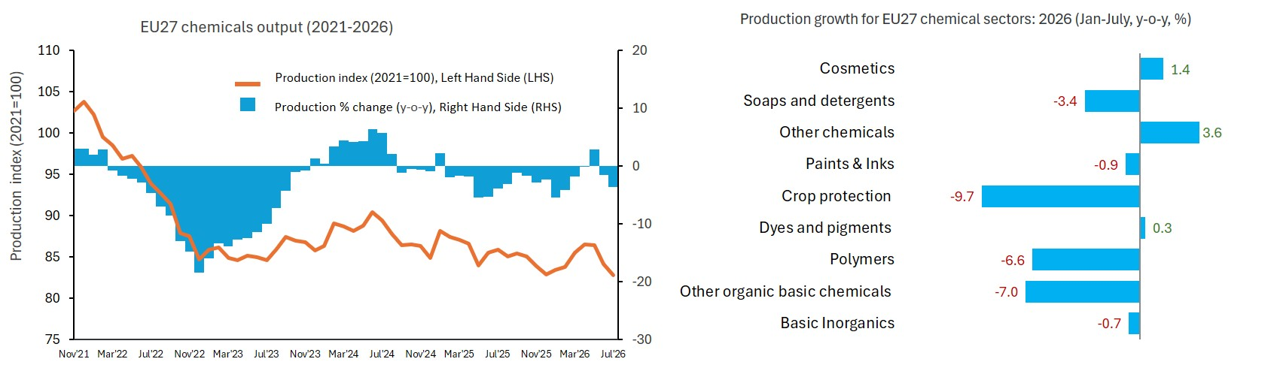
‘Other organic basic chemicals' and polymers continue to weigh on EU27 chemical production
Source: Cefic analysis based on Eurostat data, Nace 20 only
Notes:
6. Other organic basic chemicals and polymers continue to weigh on EU27 chemical production
Weaknesses remained concentrated in upstream chemical value chains. Production of other organic basic chemicals (-7.0%), polymers (-6.6%), and crop protection products (-9.7%) continued to decline, reflecting weak demand, global overcapacity and persistent competitiveness pressures. In contrast, other chemicals (+3.6%) and cosmetics (+1.4%) recorded growth, while consumer chemicals (-0.2%) remained broadly stable. Overall, consumer and specialty chemicals proved more resilient than upstream segments, highlighting the uneven performance across the industry.
Source: Cefic analysis based on Eurostat data
Latest-month assessment (July vs June 2026)
EU27 chemical production declined by 1.6% between June and July 2026, with output falling in most product groups. Other organic basic chemicals were the main exception, recording growth of 4.7%. By contrast, crop protection products fell sharply by 9.4%, while polymers, paints and inks, other chemicals, soaps and detergents, and cosmetics also declined. Overall, the July data point to continued weakness across most chemical segments, despite the rebound in other organic basic chemicals
In summary
Compared with January-July 2025, the performance of EU27 chemical sectors remained highly uneven in January-July 2026. The weakest results continued to come from upstream chemicals, particularly other organic basic chemicals, polymers and crop protection products, reflecting persistent weakness in key industrial value chains. In contrast, several specialty and consumer chemical segments proved more resilient, supported by stronger end-market demand and lower exposure to the challenges affecting basic chemicals.

Slide 7
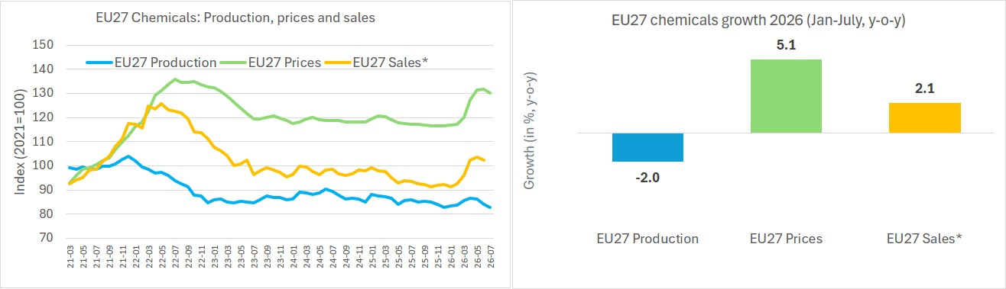
EU27 chemicals sales* 2.1% above 2025 levels
Source: Cefic analysis based on Eurostat data, Nace 20 only, *2026 (Jan-June)
Notes:
7. EU27 chemical sales rise, supported by higher prices
EU27 chemical production declined by 2.0% in January-July 2026 compared with the same period of 2025. After improving during the spring, output weakened again in June and July, with the production index falling to 82.8 in July. Physical output therefore remained well below its 2021 baseline, confirming that the sector has yet to achieve a sustained recovery.
Producer prices moved in the opposite direction, increasing by 5.1% in January-July 2026 compared with the same period of 2025. The increase accelerated from April onwards, with the price index remaining above 130 in June and July (2021=100). Higher prices therefore supported turnover despite the continued contraction in production volumes.
Source: Cefic analysis based on Eurostat data, NACE 20. Sales data cover January–June 2026; production and producer-price data cover January–July 2026.
Chemical sales increased by 2.1% in January-June 2026 compared with January-June 2025. However, as production volumes declined while producer prices increased, the improvement in sales was driven primarily by higher prices rather than stronger physical demand.
Latest-month assessment (July vs June 2026)
The latest data point to a further weakening in operating conditions. Between June and July 2026, the production index declined from 84.2 to 82.8, while the producer price index eased from 131.6 to 130.2. Sales data for July were not yet available. The simultaneous decline in output and prices suggests that the price support observed during the spring began to moderate, while physical production continued to weaken.
In summary
Compared with the same periods of 2025, EU27 chemical sales increased in the first half of 2026, while production declined in the first seven months. The increase in turnover was therefore primarily price-driven, rather than the result of stronger physical output. The latest monthly data reinforce this fragile picture, with production weakening further in July and producer prices easing slightly from their June peak.

Slide 8
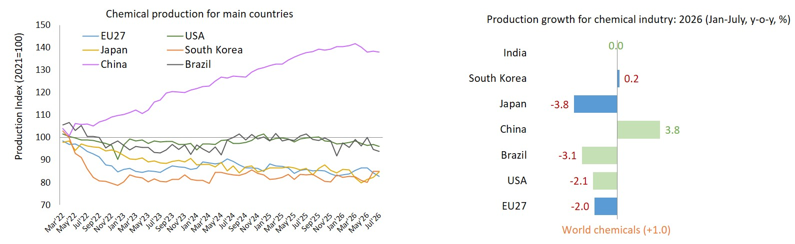
China continues to drive global growth while mature regions struggle to regain momentum
Source: Cefic analysis based on Eurostat data, Nace 20 only, *2026 (Jan-June)
Notes:
8. Global chemical production: China remains the main growth engine while most mature regions remain under pressure
Global chemical production continued to expand in 2026, but at a much slower pace than in previous years. After increasing by 3.8% in 2025, global output rose by only 1.0% year-on-year in January-July 2026. The latest data confirm that growth remains highly concentrated in a limited number of markets, while most mature chemical-producing regions continue to face weak demand, excess capacity, competitiveness challenges and subdued industrial activity.
China remained the main contributor to global growth, with chemical production increasing by 3.8% in January-July 2026. Its production index reached 138, compared with 111 for world production overall, highlighting China's continuing role as the dominant growth engine of the global chemical industry.
By contrast, production declined across most advanced chemical-producing regions. The EU27 (-2.0%), United States (-2.1%), Germany (-2.7%), Japan (-3.8%), Brazil (-3.1%) and Russia (-2.6%) all recorded lower output compared with the same period of 2025. These results underline the persistent weakness affecting many traditional chemical-producing economies.
Outside China, performance across Asia remained mixed. South Korea broadly stabilised production, while India recorded little change compared with the previous year. Although both countries outperformed most mature regions, neither matched the growth momentum seen in China. As a result, global chemical growth continues to rely disproportionately on Chinese demand and production expansion.
Source: Cefic analysis based on Eurostat and Chemdata, Nace 20.
Latest-month assessment (July vs June 2026)
The latest monthly data suggest a further loss of momentum in global chemical production. Between June and July 2026, world chemical output declined by 0.4%. Production weakened in most major producing regions, including the EU27 (-1.6%), Germany (-3.0%), the United States (-1.0%), Brazil (-0.8%), and Russia (-3.4%). China also recorded a slight decline (-0.2%), although it remained well above the production levels of other major regions. In contrast, Japan (+3.0%) rebounded and South Korea was stable, highlighting the continued divergence in regional performance.
In summary
Compared with January-July 2025, global chemical production continued to grow in January-July 2026, but growth was increasingly concentrated in China, while most mature chemical-producing regions experienced declining output. The comparison highlights a widening gap between China's expanding chemical industry and the more challenging conditions facing Europe, North America, Japan and other traditional producing regions. Overall, weak demand, overcapacity and competitiveness pressures continue to constrain growth across much of the global chemical industry.

Slide 9
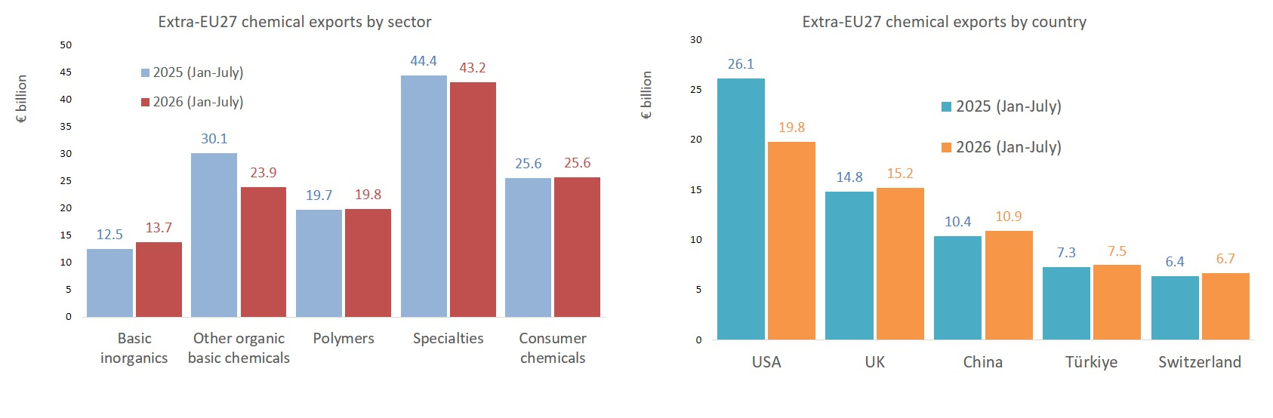
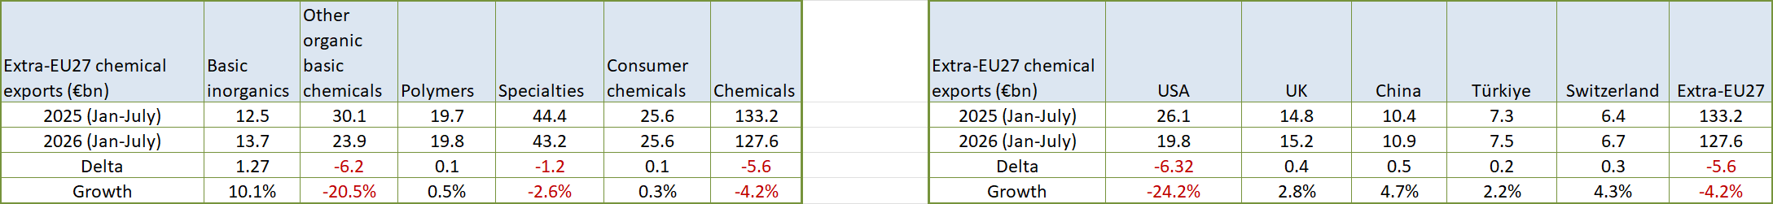
Export value falls as the US market drives the downturn
Source: Cefic analysis based on Eurostat data, Nace 20 only
Notes:
10-1. Export value falls as the US market drives the downturn
Extra-EU27 chemical exports declined by 4.2% in January-July 2026 compared with the same period of 2025. The deterioration was driven primarily by a €6.3 billion fall in exports to the United States, which accounted for most of the overall decline. At the same time, other organic basic chemicals remained the weakest export segment, with exports falling by €6.2 billion. Higher exports to China, the United Kingdom, Switzerland and Türkiye provided only a partial offset, leaving overall export performance under pressure.

Slide 10
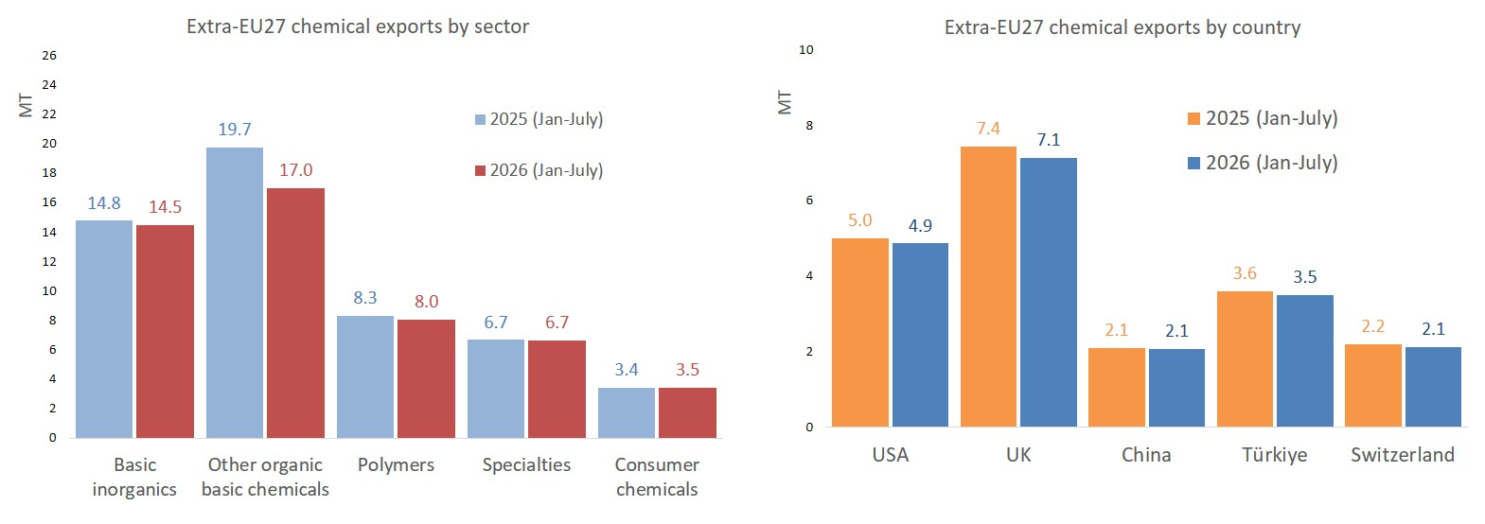
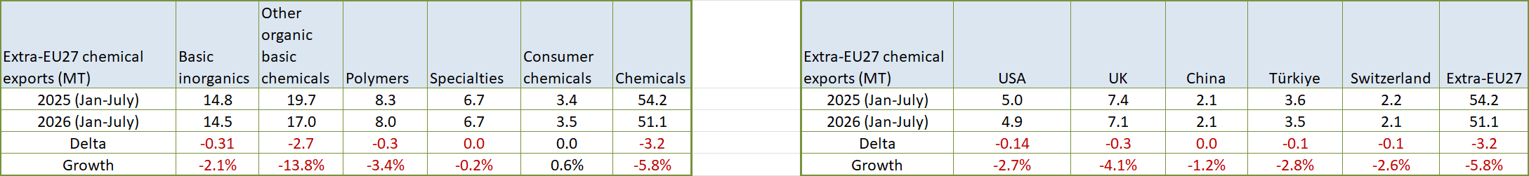
Export volumes weaken, driven by ‘other organic basic chemicals’
Source: Cefic analysis based on Eurostat data, Nace 20 only
Notes:
10-2. Export volumes weaken, driven by other organic basic chemicals
Extra-EU27 chemical export volumes declined by 5.8% in January-July 2026 compared with the same period of 2025. The downturn was driven primarily by other organic basic chemicals, which accounted for around 86% of the overall decline in export volumes, while polymers and basic inorganics also weakened. By contrast, specialty chemical exports remained broadly stable and consumer chemicals recorded modest growth. The decline was broad-based across several key export markets, including the United States, the United Kingdom, and Türkiye, pointing to softer external demand rather than weakness in a single destination

Slide 11
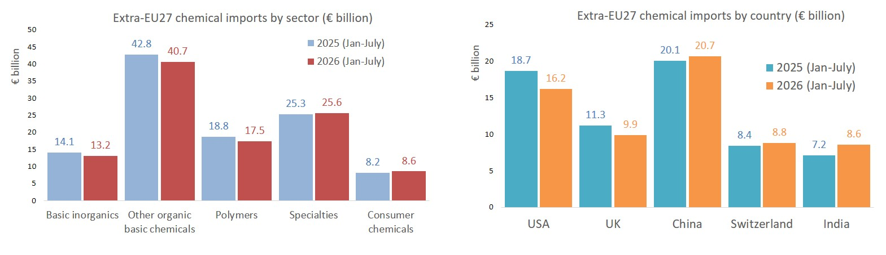
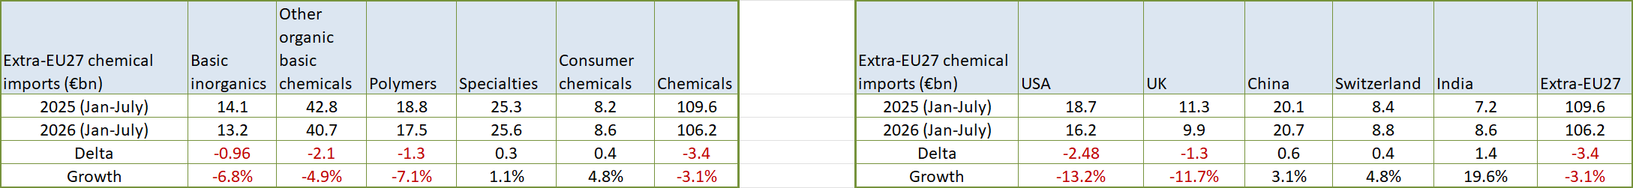
Import value declines across major upstream segments
Source: Cefic analysis based on Eurostat data, Nace 20 only
Notes:
10-3. Import value declines across major upstream segments
Extra-EU27 chemical imports declined by 3.1% in January-July 2026 compared with the same period of 2025, reflecting weaker demand for upstream chemical products. The contraction was driven primarily by other organic basic chemicals, polymers, and basic inorganics, while specialty and consumer chemicals remained more resilient. Geographically, the decline was concentrated in imports from the United States and the United Kingdom, although this was partly offset by a €1.4 billion increase in imports from India and continued growth from China. Overall, the data point to weaker demand for industrial chemical intermediates and a gradual shift in sourcing patterns toward Asian suppliers.

Slide 12
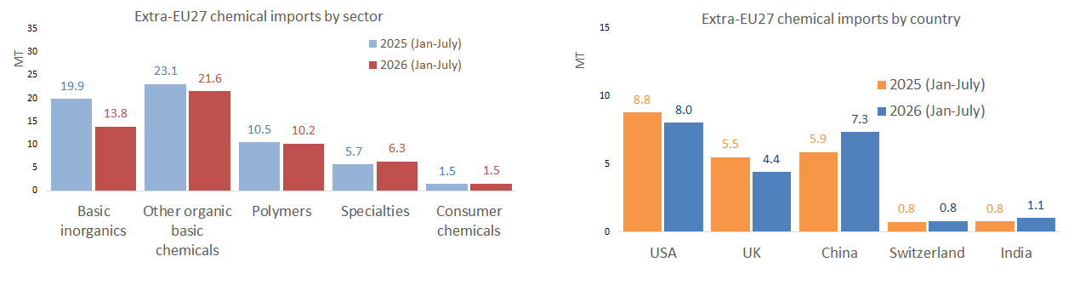
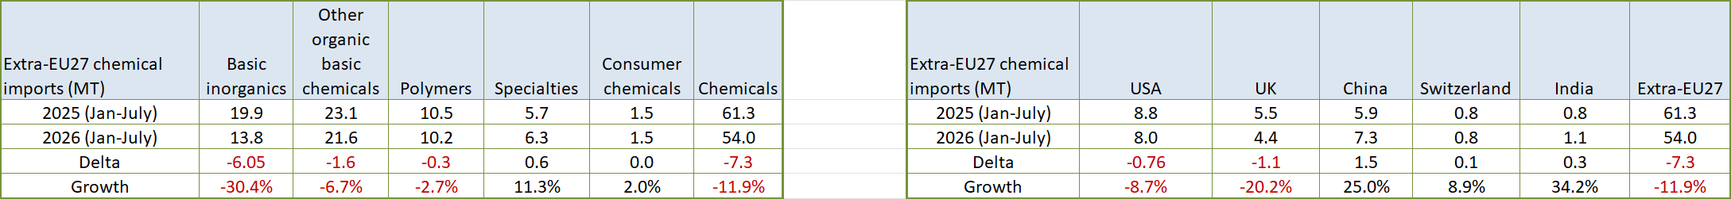
Import volumes contract sharply, driven by basic inorganics
Source: Cefic analysis based on Eurostat data, Nace 20 only
Notes:
10-4. Import volumes contract sharply, driven by basic inorganics
Extra-EU27 chemical import volumes declined by 11.9% in January-July 2026 compared with the same period of 2025, almost twice the decline recorded in import values. The contraction was concentrated in basic inorganics, which accounted for around 83% of the overall reduction in import volumes, highlighting particularly weak European demand for upstream chemical inputs. Lower imports from the United Kingdom and the United States contributed to the decline, while stronger imports from China partly offset the reduction. Overall, the narrower volume deficit reflects weaker import demand rather than stronger export competitiveness.

Slide 13
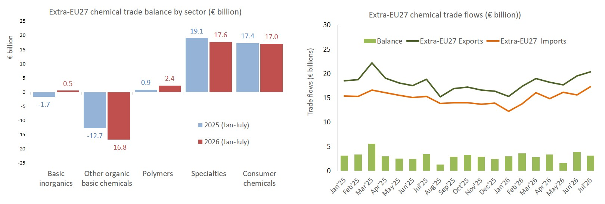
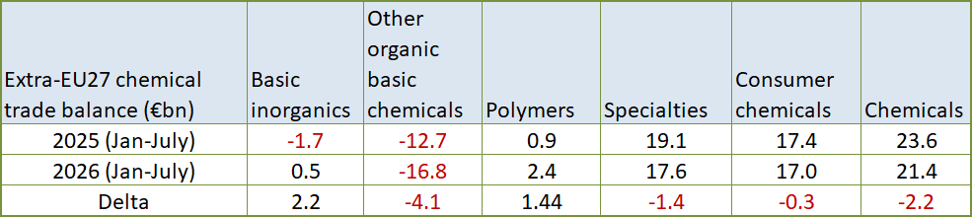
Trade surplus narrows as exports fall faster than imports
Source: Cefic analysis based on Eurostat data, Nace 20 only
Notes:
10-5. Trade surplus narrows as exports fall faster than imports
The extra-EU27 chemical trade surplus declined by €2.2 billion, from €23.6 billion in January-July 2025 to €21.4 billion in January-July 2026, as exports fell faster than imports. The deterioration was driven primarily by other organic basic chemicals, where the trade deficit widened by €4.1 billion, and by a weaker trade balance with the United States, which deteriorated by €3.8 billion. These losses were partly offset by stronger balances in basic inorganics and polymers, as well as an improvement in trade with the United Kingdom. Overall, the data highlight continued pressure on upstream chemical value chains and a less favourable external trade environment for the EU27 chemical industry.

Slide 14
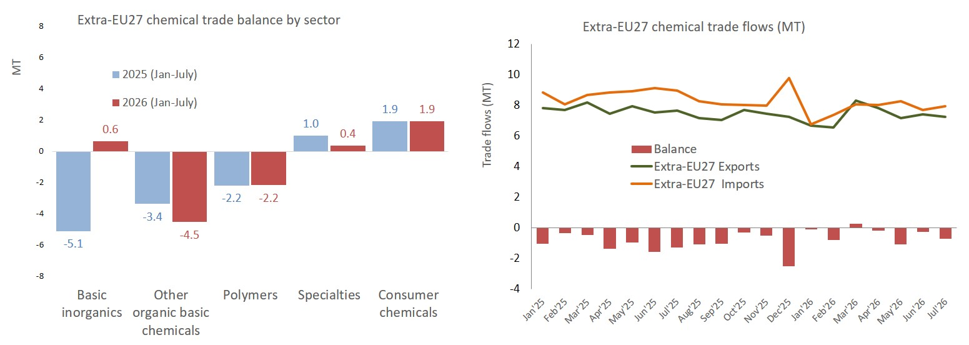
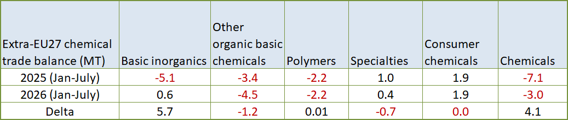
Volume deficit narrows as imports contract much faster than exports
Source: Cefic analysis based on Eurostat data, Nace 20 only
Notes:
10-6. Volume deficit narrows as imports contract much faster than exports
The extra-EU27 chemical trade deficit in volume terms improved by 4.1 million tonnes, narrowing from 7.1 million tonnes in January-July 2025 to 3.0 million tonnes in January-July 2026. The improvement was driven primarily by basic inorganics, where the volume balance strengthened by 5.7 million tonnes, more than offsetting weaker balances in other organic basic chemicals and specialty chemicals. Geographically, the volume position improved with the United Kingdom and the United States, while the deficit with China widened by 1.5 million tonnes as imports from China continued to increase. Overall, the smaller volume deficit reflects a sharp contraction in imports rather than stronger export competitiveness.

Slide 15
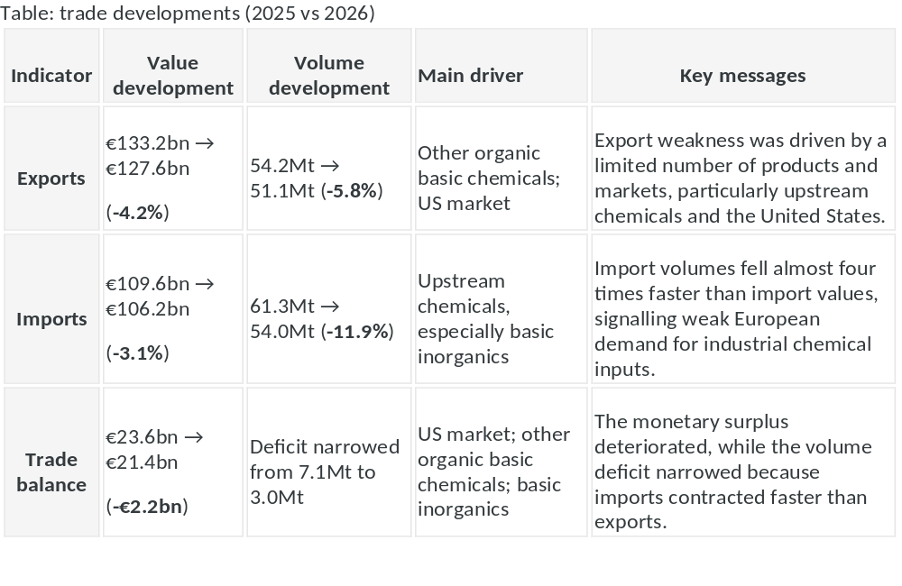
EU27 chemical trade performance January–July 2026 versus January–July 2025
Source: Cefic analysis based on Eurostat data, Nace 20 only
Notes:
9. EU27 chemical trade performance January–July 2026 versus January–July 2025
Executive overview
EU27 chemical trade weakened in the first seven months of 2026. Export values declined by 4.2%, while imports fell by 3.1%, reducing the extra-EU27 chemical trade surplus by €2.2 billion to €21.4 billion. The deterioration was driven primarily by lower exports of other organic basic chemicals and weaker sales to the United States. At the same time, import values fell as demand for upstream chemical products weakened, particularly imports from the United States and the United Kingdom.
EU27 chemical trade weakened in both value and volume terms during January-July 2026. Export performance deteriorated as demand weakened in key markets, particularly the United States, while import volumes contracted sharply, reflecting weaker European demand for upstream chemical products. As a result, the value trade surplus narrowed, even though the volume deficit improved.
In summary
Exports remained under pressure, led by lower sales of other organic basic chemicals and weaker demand from the United States.
Import volumes contracted sharply, mainly because purchases of basic inorganic products declined significantly.
The narrower volume deficit does not indicate stronger competitiveness; it reflects weaker import demand rather than stronger export performance.
Trade conditions remained challenging, with upstream chemical value chains accounting for most of the deterioration in EU27 trade performance.

Slide 16
The EU27 chemical industry remains under pressure despite improving confidence
Overall Message: Despite improving business confidence and easing inventory pressures, the EU27 chemical industry remains under strain. Production continues to decline, demand is weak, and structural competitiveness pressures are intensifying. A broad-based and sustainable recovery has yet to emerge.
Key Takeaways
  Business confidence has increased slightly, but order books remain well below normal and employment expectations have deteriorated.
  Chemical production declined by 2.0% in 2026 vs 2025, and remains significantly below pre-crisis levels.
  While higher prices have supported turnover, production volumes continue to contract, indicating that underlying industrial demand remains weak.
  Performance remains highly uneven across Member States, with upstream chemicals under the greatest pressure and only selected countries and segments recording growth.
  China remains the principal global growth engine, while production contracted across most mature chemical-producing regions.
  The trade surplus further narrowed in 2026 vs 2025 as exports fell faster than imports, particularly because of weaker exports to the United States and other organic basic chemicals.

